Slide 1
Using the fx-83/85GT CW for statistics
Task A: Finding the mean from a frequency table
1) This frequency table shows the number of goals scored in each match by all the teams in a club over one football season.
Goals scored | Frequency
0 | 19
1 | 34
2 | 21
3 | 15
4 | 11
What was the mean number of goals scored?
1.65 goals (which rounds to 2)
2) This frequency table shows the star rating received by a restaurant over its opening weekend.
Star rating | Frequency
1 | 12
2 | 18
3 | 21
4 | 38
5 | 45
What was the mean star rating?
3.64… stars (which rounds to 4)
3) A class take a quiz, marked out of 6. The frequency table shows the results for the class.
Quiz score | 0 | 1 | 2 | 3 | 4 | 5 | 6
Frequency | 3 | 4 | 4 | 7 | 10 | 4 | 1
What is the mean number of marks per pupil?
3 marks

Slide 2
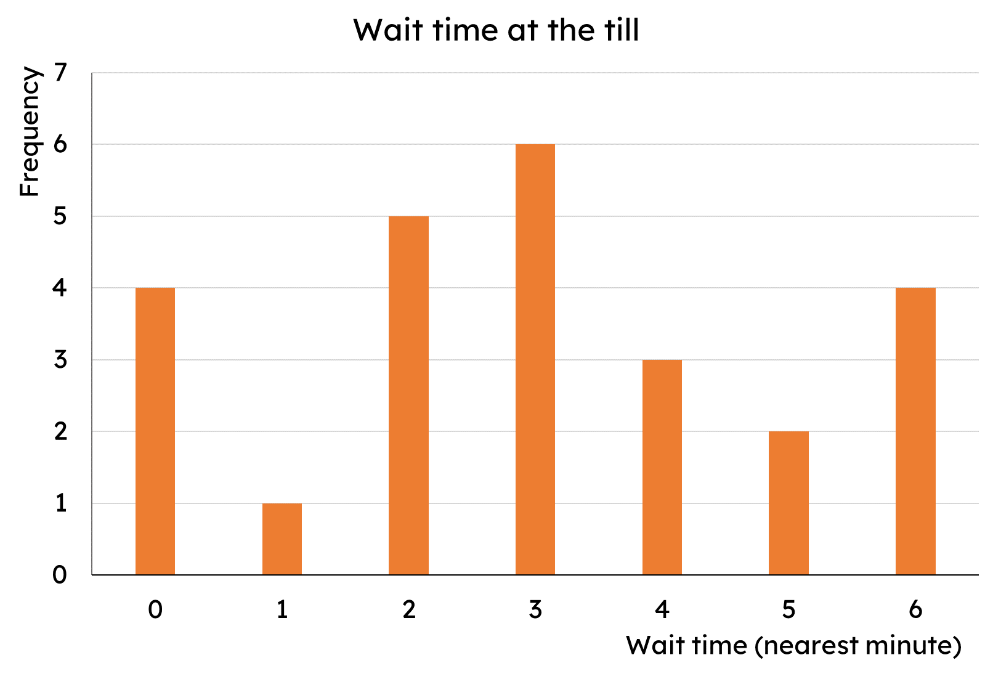
Using the fx-83/85GT CW for statistics
4) The frequency table shows the number of bedrooms in different houses within an area of a town.
Bedrooms | Frequency
1 | 20
2 | 93
3 | 54
4 | 33
What is the mean number of bedrooms?
2.5 bedrooms (which rounds to 3)
5) The bar chart shows the length of time customers spent waiting at a self-service till (to the nearest minute).
What is the mean wait time?
3 minutes
Task B: Analysis
1) This frequency table shows the number of goals scored in each match by all the teams in a club over one football season.
Goals scored | Frequency
0 | 19
1 | 34
2 | 21
3 | 15
4 | 11
a) Calculate the median.
1 goal
b) Calculate the interquartile range.
3 − 1 = 2 goals
c) Would the club prefer to report the mean or median as the average number of goals scored? Why?
Mean = 1.65 goals. Median = 1 goal.
The club would prefer to report the mean as it rounds to 2 goals making the club’s performance look better.

Slide 3
Using the fx-83/85GT CW for statistics
2) This frequency table shows the star rating received by a restaurant over its opening weekend.
Star rating | Frequency
1 | 12
2 | 18
3 | 21
4 | 38
5 | 45
a) Calculate the median.
4 stars
b) Calculate the interquartile range.
5 − 3 = 2 stars
c) Would the restaurant prefer to report the mean or median as the average rating? Why?
Mean = 3.64… stars. Median = 4 stars.
The restaurant could report either but the median does not need to be rounded.
3) The frequency table shows the number of bedrooms in different houses within an area of a town.
Bedrooms | Frequency
1 | 20
2 | 93
3 | 54
4 | 33
A developer wishes to build more expensive houses (3+ bedrooms) but the local council want cheaper housing. The council argue that there are already enough houses with 3 or more bedrooms.
Are the council correct? Use the data to support your decision.
Mean = 2.5 bedrooms. Median = 2 bedrooms.
Interquartile range = 3 − 2 = 1
E.g.
If the council uses the mean, then they can round and state that the average number of bedrooms in houses in this area is 3. Therefore there are plenty of houses with 3 (or more) bedrooms in.
4) The bar chart shows the length of time customers spent waiting at a self-service till (to the nearest minute).
Management want every customer to be queuing for less than the average queue time.
a) Calculate the average queue time.
Mean = Median = Mode = 3 minutes
b) Explain why it is not possible for everyone to queue for less time than the average queue time.
Averages are a measure of central tendency. It is possible for everyone to queue for the average time but not for everyone to be below. If everyone’s time decreased, so would the average.
Mathematics in Education and Industry
v2.5

